Slide 1

Design And Analysis Of Piston By Using SolidWorks & Ansys Software
Group No. 52
Presented by:
Gautam Kumar (1414101086)
Prashant Kumar (1414101277)
Sanjay Singh (1414101185)
Ramesh Kumar Prajapati (1414101164)
Guided By:
Mr. Manoj Kumar

Slide 2
OBJECTIVES
To design an IC engine (piston and piston ring) by using SolidWorks Software
To perform the structural and thermal analysis (of piston) using ANSYS 15 Software.
To investigate the maximum stress using stress analysis.
To investigate the maximum temperature using thermal analysis.

Slide 3
PISTON:-
A piston is a component of reciprocating IC-engines. It is the moving component that is contained by a cylinder and is made gas-tight by piston rings. In an engine, its purpose is to transfer force from expanding gas in the cylinder to the crankshaft via a piston rod. Piston endures the cyclic gas pressure and the inertial forces at work, and this working condition may cause the fatigue damage of piston, such as piston side wear, piston head cracks and so on.

Slide 4
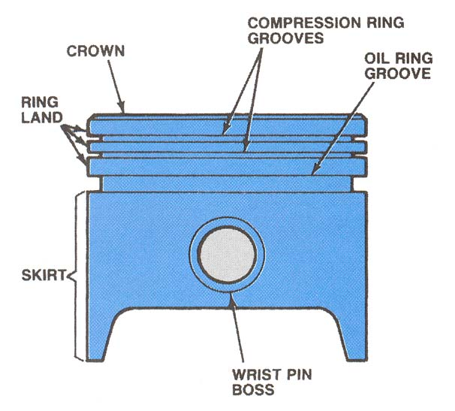
Figure 1: Parts of a piston

Slide 5
Piston in an IC engine must possess the following characteristics:-
Strength to resist gas pressure.
Must have minimum weight.
Must be able to reciprocate with minimum noise.
Must have sufficient bearing area to prevent wear.
Must seal the gas from top and oil from the bottom.
Must disperse the heat generated during combustion.
Must have good resistance to distortion under heavy forces and heavy temperature.

Slide 6
FUNCTIONS OF THE PISTONS:-
To receive the impulse from the expanding gas & transmit the energy to the crank shaft through the connecting rod.
It transmits the force of combustion gases to the crank shaft.
It controls the opening & closing of the parts in a 2-stroke engine.
It acts as a seal to escape of high pressure gases in to the crank case.

Slide 7
SCOPES OF THE PROJECT
A several needs to be identified in order to analysis the piston. This project will be focusing on an analysis of the failure of the piston. This scope are will be done first by finding the literature review about the piston , SOLIDWORK software and ANSYS software. Next, the type of piston that is used for petrol engine from automobile and four-stroke cycle will be analysed. Then, all information about piston will be collected. Besides that, the material that will be used is aluminium alloy. The others scope is to design the piston using SOLIDWORK software and analysis by ANSYS software. Finally, the maximum stress and maximum temperature will be determined.

Slide 8
Methodology
Procedure of analysis :
Collection of Engineering data.
Making the 3D design of piston in Solidworks software.
Import this geometry from the SolidWorks to Ansys software.
Specify element type & feed the material property.
At the point of gudgeon pin fix.
Mesh the object.
Apply boundary conditions & External loads.
Analysis of Piston on different criteria like deformation , stress distribution etc.
Generate solution.

Slide 9
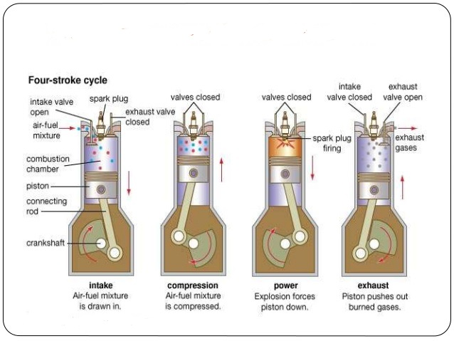
Function : -

Slide 10
CHARACTERSTICS OF PISTON:-
Hammering effect of a combustion gas
pressure.
High temperature of the gases.
Light in weight silent in a operation &Mechanically strong.
An Internal Combustion Engine is that kind of prime mover that converts chemical energy to mechanical energy. The fuel on burning changes into gas which impinges on the piston and pushes it to cause reciprocating motion. The reciprocating motion of the piston is then converted into rotary motion of the crankshaft with the help of connecting rod. IC engines are used in marine locomotives, aircrafts, automobiles and other industrial applications.

Slide 11
PROBLEM DEFINITION:-
The function of the piston is to absorb the energy released after the combustion and to produce useful mechanical energy. When the combustion of fuel takes place in heavy diesel engine cylinder, high temperature and pressure develops. Because of high speed and at high loads, the piston is subjected to high thermal and structural stresses. The investigations indicate that the greatest stress appears on the upper end of the piston and stress concentration is one of the main reason for fatigue failure. Due to stress concentration and high thermal load the upper end of the piston, crack generally appears. This crack may even split the piston.

Slide 12
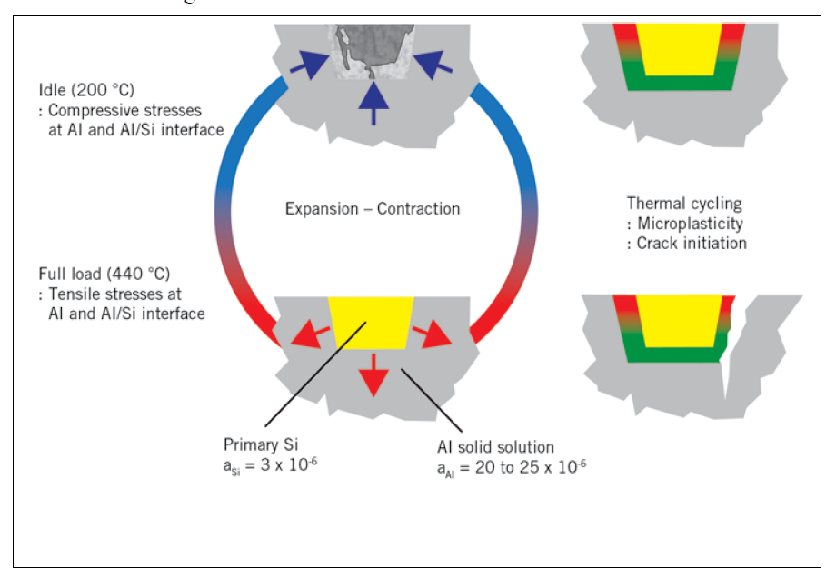
Figure 3 : Thermo – mechanical fatigue induced by micro –plasticity after thermal cycling

Slide 13
The main objectives are
To investigate the maximum stress using stress analysis.
To investigate the maximum temperature using thermal analysis.
The pistons will produce stress and deformation because of the periodic load effect, which are from high gas pressure, high speed reciprocating motion from the inertia force, lateral pressure, friction and so on. Burning of the high pressure gas products high temperature, which makes piston expands in order that its interior produces thermal stress and thermal deformation. The thermal deformation and mechanical deformation will cause piston cracks, tortuosity, etc.

Slide 14
LITERATURE REVIEW:-
R.A. Saravanan, M.K. Surappa et al. “Fabrication and characterisation of pure magnesium-30 vol.% SiC particle composite”. The magnesium 30 vol.% SiC composite was processed by melt stir technique. The matrix material was99% pure magnesium and SiC particles with 40 mm average size. Steps involved and the procedure employed for the fabrication of the melting was carried out using a resistance heating furnace of 5 KW. Fracture behaviour of pure magnesium reveals elongated dimples at room temperature and circular dimples at high temperatures. Sliding wear rate of the Mg-30 vol.% SiC composite is two order of magnitude less compared to unreinforced magnesium.

Slide 15
LITERATURE REVIEW….
Malarvannan, P. Vignesh et al. “Experimental Investigation and Analysis of Piston by using Composite Materials‟ The increased hardness of the material ensures the less deformation due to impact loads and keeps the material strong enough to with stand loads. The Young's modulus of the material is higher compared to the smaller composition and the tensile strength of the material is also increased to the virgin material. This shows that the AlSic is better in all the aspects when compared to the Aluminium. Models for the simulation were prepared using Pro Engineer. This software enables to create 3-dimentional model of the piston and to define physical properties of the materials used. Analysis of thermal loads and piston deformations was done by finite elements method using ANSYS software.

Slide 16
LITERATURE REVIEW…
Praful R. sakharkar et al. “Thermal analysis of ic engine piston using FEA”. The finite element analysis is performed using CAD software to investigate and analyze thermal stress distribution at the real engine condition during combustion process. Piston skirt may appear deformation usually causes crack on the upper end of the piston head. Due to deformation, stress concentration is caused on the upper end of the piston and the stress distribution on the piston mainly depends on the deformation of piston. Therefore piston crown should have enough stiffness to reduce the deformation

Slide 17
LITERATURE REVIEW…
C.H. Li, et al. ‘Piston thermal deformation and friction considerations’ The thermal analysis of piston is important from different point of views most of the internal combustion (IC) engine pistons are made of aluminium alloy which has a thermal expansion coefficient 80% higher than the cylinder bore material made of cast iron. This leads to some differences between running and the design clearances. Therefore, analysis of the piston thermal behaviour is extremely crucial in designing more efficient engines. First, the highest temperature of any point on piston should not exceed 66% of the melting point temperature of the alloy.

Slide 18
LITERATURE REVIEW….
Vinoth M. A et al. “Development and Assessment of Piston by using Al-Si Hybrid Metal Matrix Composites Reinforced with SiC and Cenosphere Particulates‟ During the working condition piston exposed to the high gas pressure because of combustion. So the methodology for analyze the piston is to consider the gas pressure as applied uniformly over the piston crown. The pressure force generated by the burning of fuel is calculated using gas equation and it is assumed that side thrust force and inertia force is negligible but in reality this may have some influence on stress and deformation of piston

Slide 19
MODELLING OF PISTON BY USING SOLIDWORKS:
Solid works is a 3D design app for parametric modelling parametric featured based solid modelling. To build a company that developed 3D CAD software that was easy-to-use, affordable and available on the desktop, with its headquarters at Concord, Massachusetts, and released its first product, SolidWorks 95, in 1995
The design of the piston starts with the definition of the piston geometry using ‘Solidworks’ software. This 3D geometric model is then imported to ‘Ansys’ software and analysed under the predicted service conditions before anything is made. That speeds up the design and testing process, reduces the lead time to create new pistons designs, and produces a better product.

Slide 20
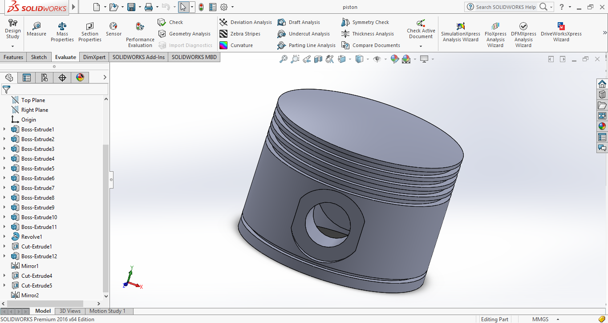
Figure : 3D Model of Piston in Solidworks

Slide 21
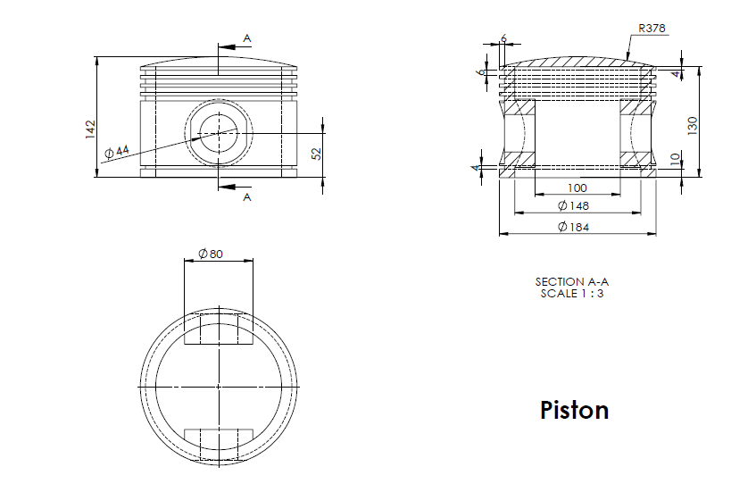

Slide 22
COMPOSITE MATERIAL :-
Composite materials (also called composition materials or shortened to composites) are materials made from two or more constituent materials with significantly different physical or chemical properties, that when combined produce a material with characteristics different from the individual components. The individual components remain separate and distinct within the finished structure. The new material may be preferred for many reasons common examples include materials which are stronger, lighter or less expensive when compared to traditional materials.

Slide 23
MATERIALS AND THEIR PROPERTIES:-
 | Al alloy 4032 | Titanium Ti-6AI-4V
Poisson ratio | 0.35 | 0.342
Modulus of elasticity(GPa) | 79 | 113.8
Thermal Conductivity (w/m k) | 155 | 6.7
Ultimate tensile strength (MPa) | 380 | 950
Yield tensile strength (MPa) | 315 | 880
Density g/cc | 2.68 | 4.43

Slide 24
The piston and piston rings are designed according to procedures and specifications given in machine design and design data book. Dimensions are calculated and these are used for modelling the piston in Solidworks.
MATERIALS AND THEIR PROPERTIES:-

Slide 25
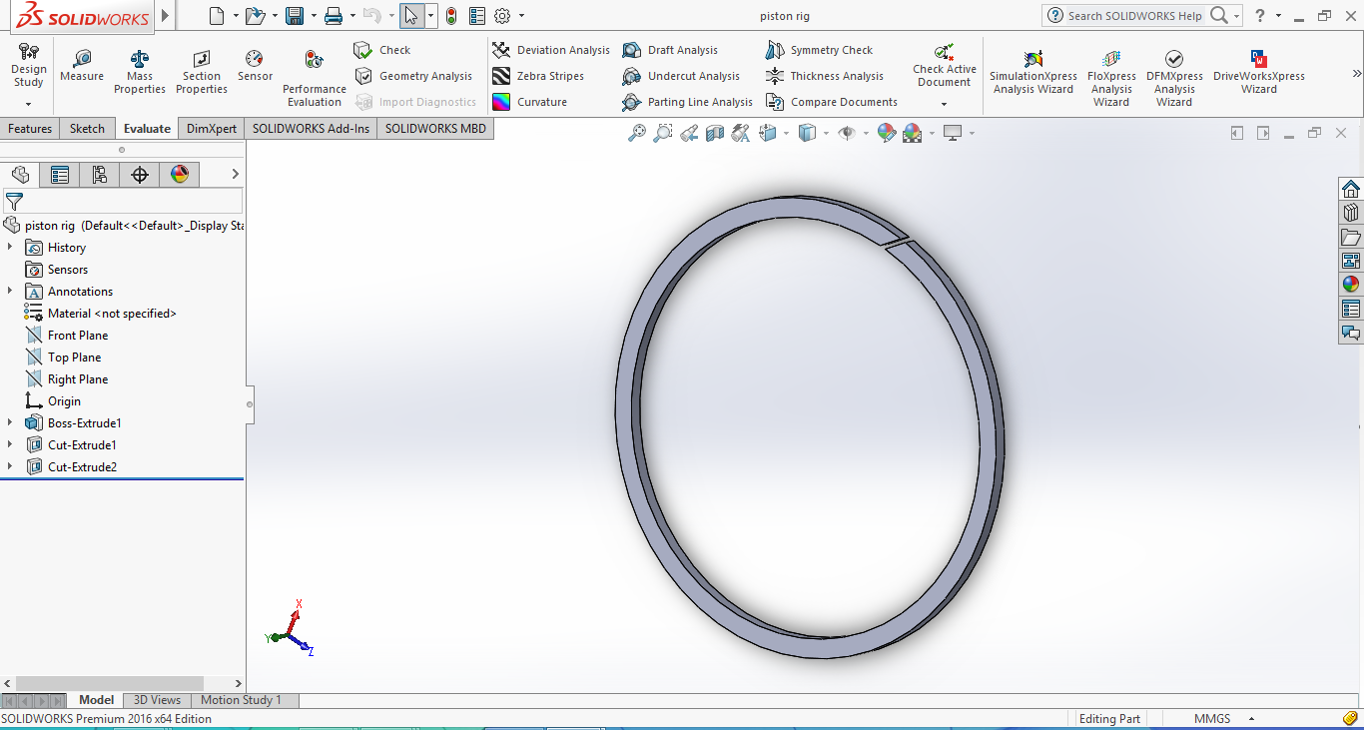
Figure : 3D Model of Piston ring in Solidworks

Slide 26
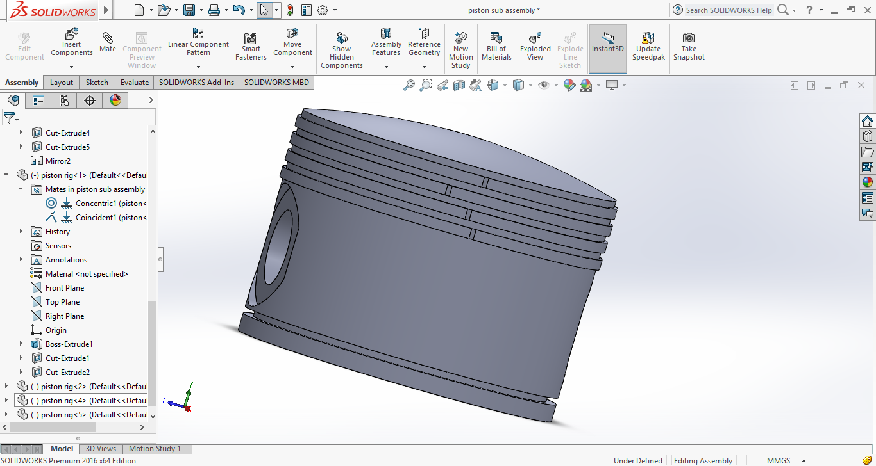
Figure : 3D Model of Piston in Solidworks

Slide 27
Analysis of Al alloy 4032
Figure : Total deformation on Alloy 4032 Piston
Figure : Equivalent Stress of Al alloy 4032 Piston

Slide 28
Figure : Normal stress on Al alloy 4032 Piston
Figure : Equivalent elastic strain on Al alloy 4032 Piston

Slide 29
Results of Al alloy 4032
 | Total deformation (mm) | Equivalent stress (MPa) | Equivalent strain | Normal stress (MPa)
Minimum | 0 | 0.98956 | 3.1738e-5 | -221.4
Maximum | 0.11457 | 439.29 | 0.0055622 | 135.78

Slide 30
Analysis of Ti-6Al-4V
Figure : Total deformation on Alloy 4032 Piston
Figure : Equivalent Stress of Al alloy 4032 Piston

Slide 31
Figure : Equivalent elastic strain on Al alloy 4032 Piston
Figure : Normal stress on Al alloy 4032 Piston

Slide 32
Results of Ti-6Al-4V
 | Total deformation (mm) | Equivalent stress (MPa) | Equivalent strain | Normal stress (MPa)
Minimum | 0 | 0.98249 | 2.1592e-5 | -210.69
Maximum | 0.079662 | 439.42 | 0.0038624 | 133.7

Slide 33
REFRENCES
Ekrem Buyukkaya , Muhammet Cerit (2007) „Thermal analysis of a ceramic coating diesel engine piston using 3-Dfinite element‟, Surface & Coatings Technology 202 398–402
R.A. Saravanan, M.K. Surappa (2000) „ Fabrication and characterisation of Pure magnesium-30 vol. % SiCP particle composite‟, Materials Science and Engineering A276 V0l.108–116
C.H. Li, (1982) „ Piston thermal deformation and friction considerations‟, SAE Paper, vol. 820086
R.S.Khurmi, J.K.Gupta, A Text Book of Machine Design, S.Chand& Co., pp. 1132-1144, 2004.
V. B Bhandari a Text Book of Machine Design and also its data book.

Slide 34
REFRENCES
Fig. 1 slide no 4 – https://mechanical-engg.com/gallery/image/1819- parts-of-pistonjpg/
Fig. 2 slide no 9- www.wikipedia.org/wiki/Four-stroke_engine
Fig. 3 slide no 12- https://www.sciencedirect.com/science/article/pii/S1359431105001523
www.google.com

Slide 35
THANK YOU

